Slide 1

Shopee Price Match Guarantee
Project 5
Group 1

Slide 2
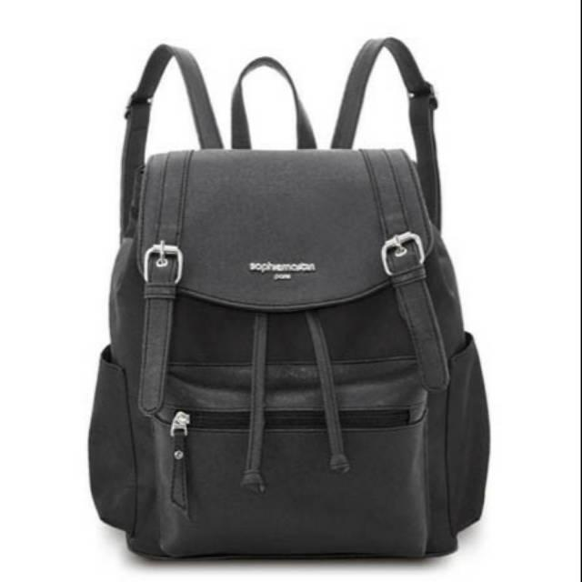
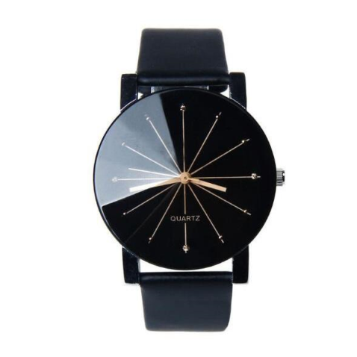

Project Objective
Build a model that predicts which items are the same products within a dataset composed of more that 70 000 items.

Slide 3

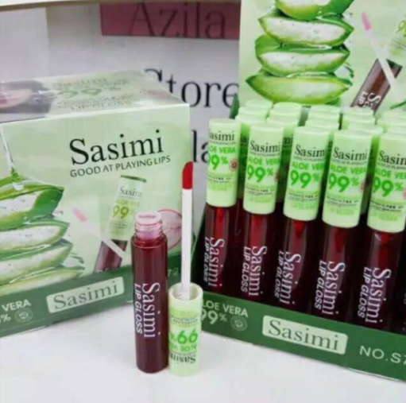
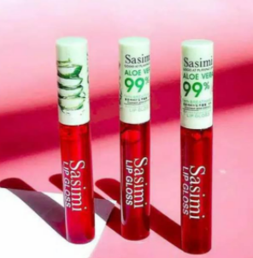
General Approach
Exploratory Data Analysis
Title – Product Description | Image
Natural Language Processing | Image Processing
Use Pre-Trained Models
Group items based on product
Evaluate and adjusted each models based on f1-score from training data
Combine groups generated from titles and images
Submit model to Kaggle to evaluate and adjust model based on f1-score on the hidden dataset composed of more than 70 000 items

Slide 4
Natural Language Processing
Main Challenges
Product descriptions were written in more than one language.
A given product description could be composed of more than one language.
Potential Solutions
Language Agnostic Sentence Representation (LASER).
Identification of the main languages used in the dataset and translation to English.
Identification of most frequents words and if necessary, translate manually the most common words to English.
MarianMT models used to translated from Indonesian to English (Huggingface).
Best Solution
Text Embedding : TF-IDF while keeping the numbers in the product description.
Grouping : Pairwise distance matrix or k-nearest-neighbor where distance is calculated with the cosine methodology was used to compare product description. This method was implemented with batches to manage memory issues which occurred with the hidden dataset.
F1-score of 0.62 on complete training data.

Slide 5
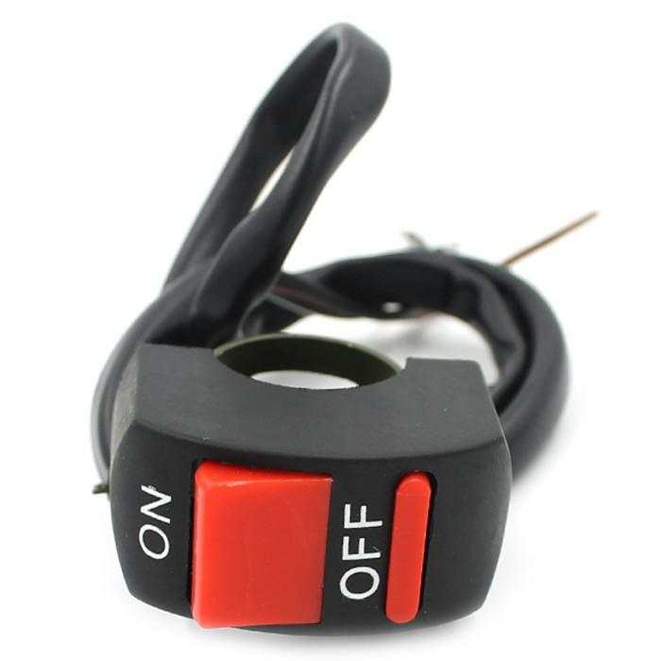
Unsupervised model
pHash : precise but limited
Language model (NLP) : good for similar texts and different images
Image embeddings (EfficientNetB5) : good for similar images and different texts
Combine all predictions : should be better right ?

Slide 6
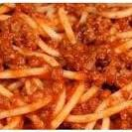
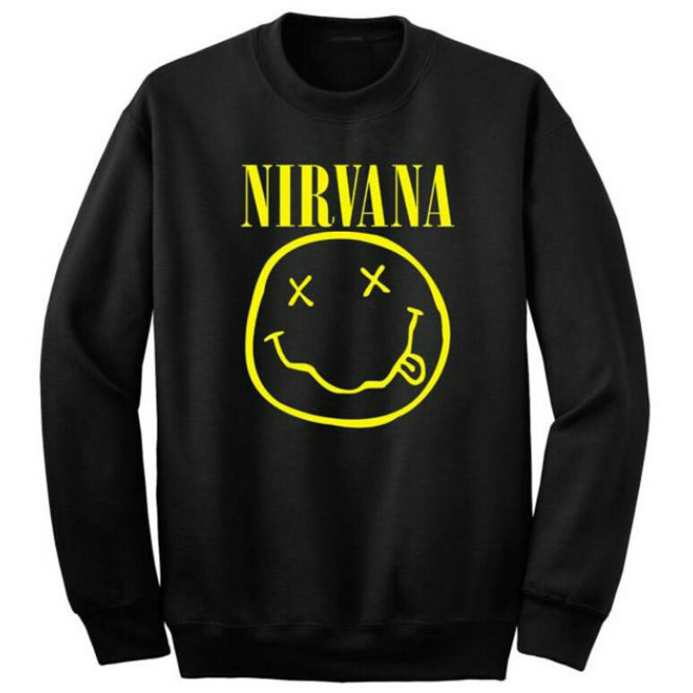
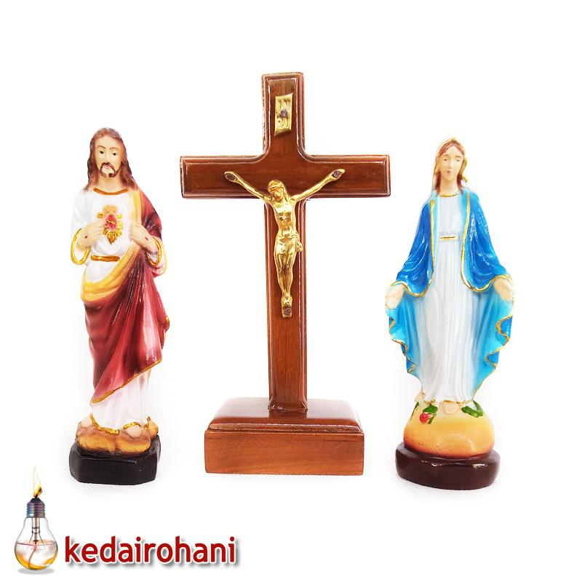
Preliminary results
pHash : 0.554
Language model : 0.624
Image embeddings : 0.613
Combined predictions : 0.692
Best combinaison ?

Slide 7
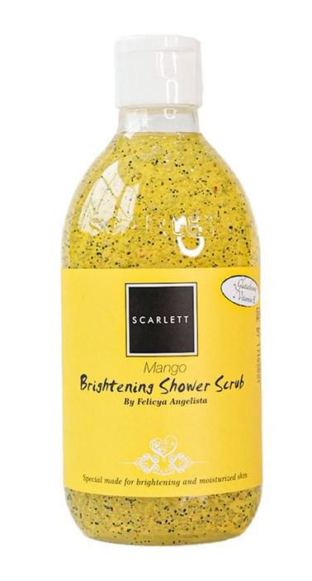
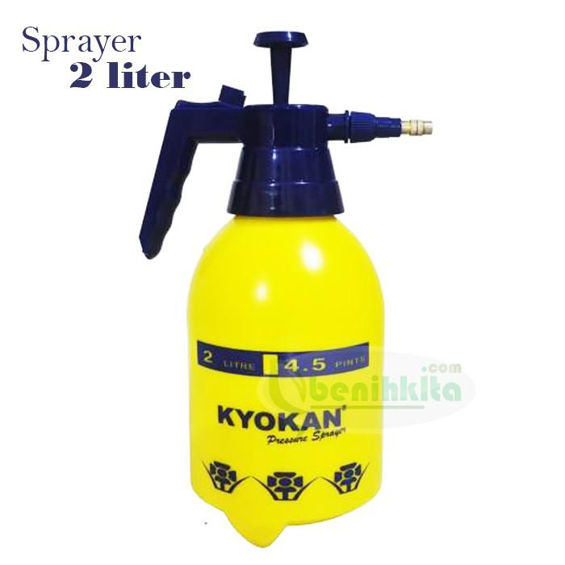
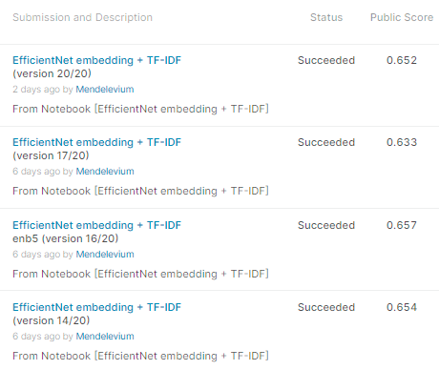
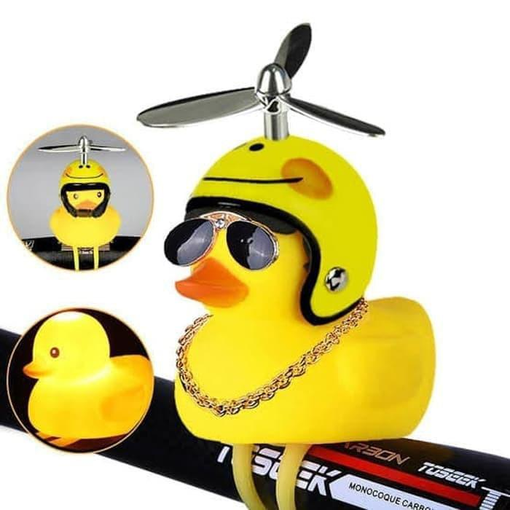
Kaggle submissions
Next logical step: get better image prediction and better grouping

Slide 8
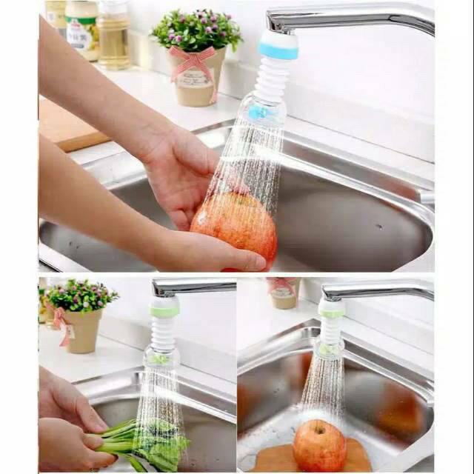
Initial Attempt
Methodology and code from Dive into Deep Learning online book was used to download a pre-trained model (in this case ResNet34), modify the top layer and train it on 6,000 images.
Images were not selected at random but with large groups as it was felt that this would be best for matching generated features to labels.
The model was saved and used on various tests both with and without large classes.

Slide 9
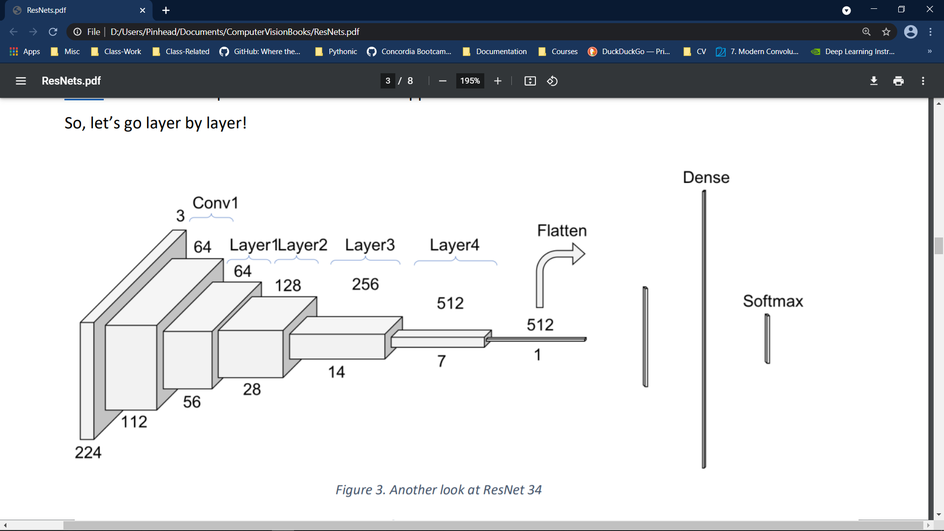
ResNet34

Slide 10
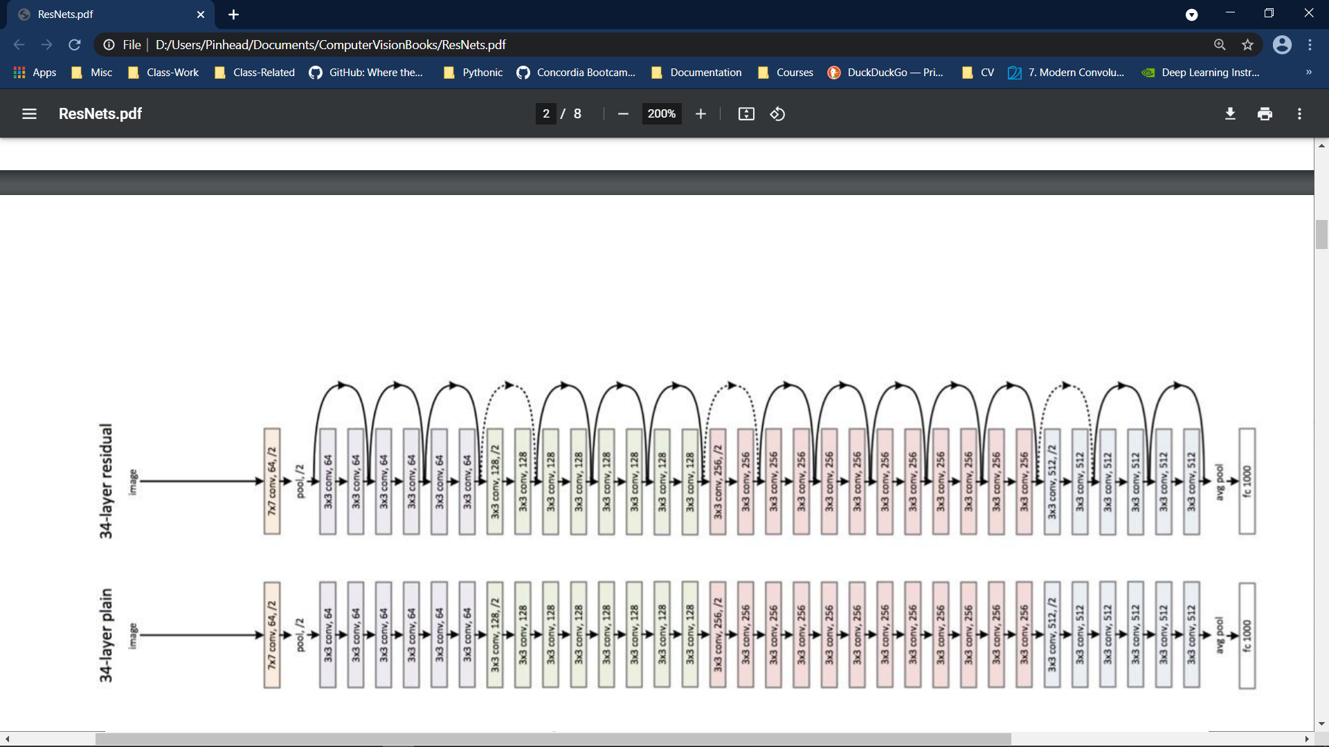
ResNet34

Slide 11
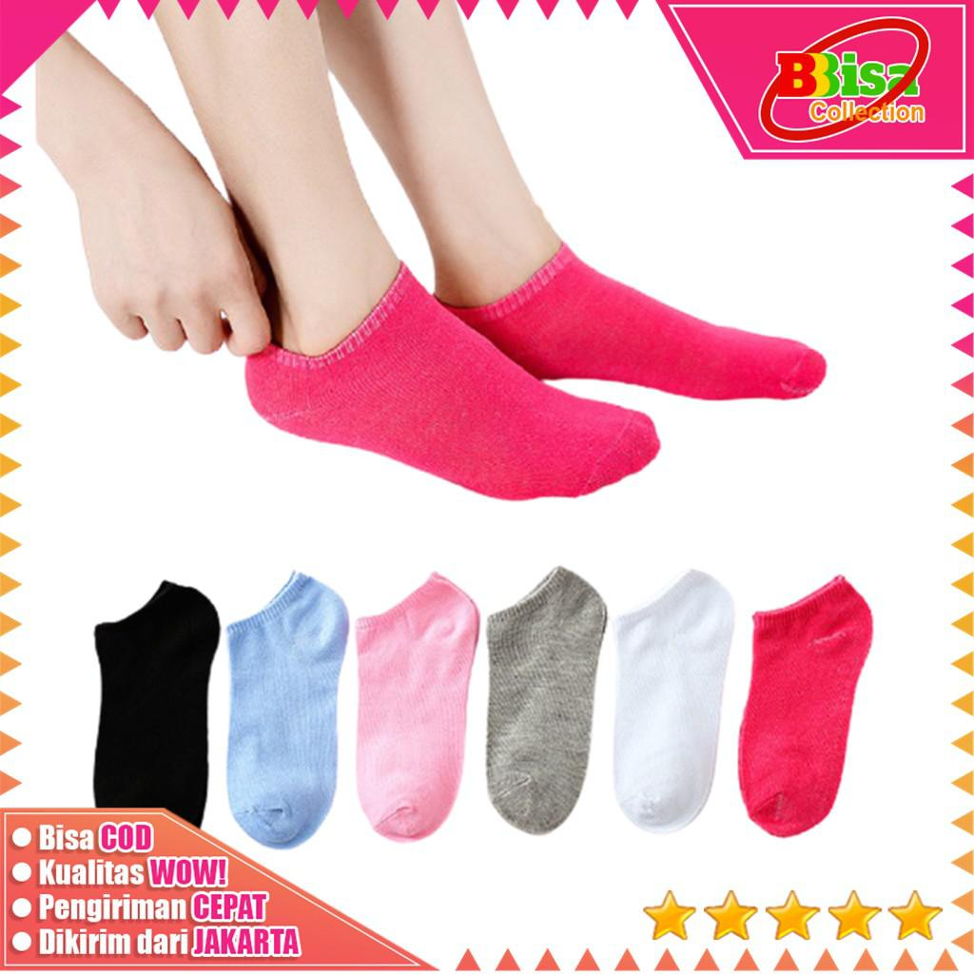
Details of the initial model
This initial model included some pre-processing wherein resizing, random cropping and image manipulation took place.
transform_train = torchvision.transforms.Compose([
# Randomly crop the image to obtain an image with an area of 0.08 to 1 of
# the original area and height to width ratio between 3/4 and 4/3. Then,
# scale the image to create a new image with a height and width of 224
# pixels each
torchvision.transforms.RandomResizedCrop(224,
scale=(0.08, 1.0),
ratio=(3.0 / 4.0, 4.0 / 3.0)),
torchvision.transforms.RandomHorizontalFlip(),
# Randomly change the brightness, contrast, and saturation
torchvision.transforms.ColorJitter(brightness=0.4,
contrast=0.4,
saturation=0.4),
torchvision.transforms.ToTensor(),
# Standardize each channel of the image
torchvision.transforms.Normalize(
[0.485, 0.456, 0.406],
[0.229, 0.224, 0.225])])

Slide 12
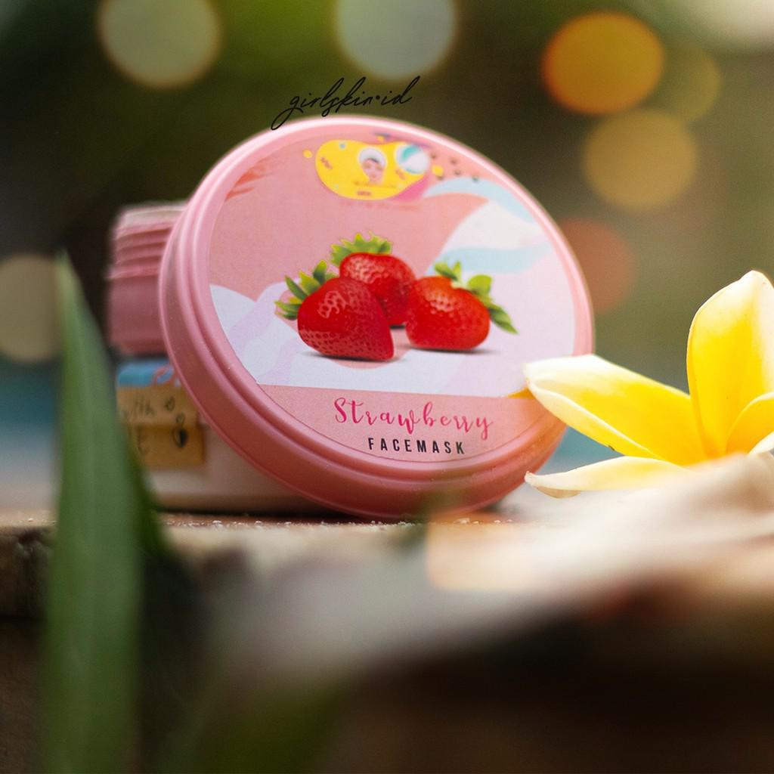
Details of initial model (continued): test pre-processing
The test image pre-processing is a subset of the training pre-processing:
transform_test = torchvision.transforms.Compose([
torchvision.transforms.Resize(256),
# Crop a square of 224 by 224 from the center of the image
torchvision.transforms.CenterCrop(224),
torchvision.transforms.ToTensor(),
torchvision.transforms.Normalize(
[0.485, 0.456, 0.406],
[0.229, 0.224, 0.225])])

Slide 13
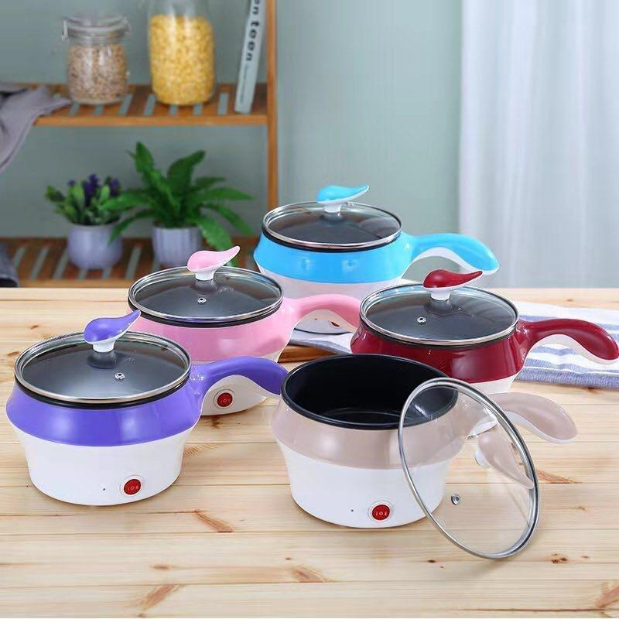
Details of initial model (continued): top layer
The top layer was modified for the number of classes in the training dataset:
def get_net(devices):
finetune_net = nn.Sequential()
finetune_net.features = torchvision.models.resnet34(pretrained=True)
# Define a new output network
# There are 533 output categories
finetune_net.output_new = nn.Sequential(nn.Linear(1000, 256),
nn.ReLU(),
nn.Linear(256, 533))
# Move model to device
finetune_net = finetune_net.to(devices[0])
# Freeze feature layer params
for param in finetune_net.features.parameters():
param.requires_grad = False
return finetune_net

Slide 14

The output class issue
The model as presented can’t really be used to predict precise labels because the number of labels is not fixed – as well as being unknown for the test dataset.
Another Kaggler used the norm of the output feature matrix to identify similar samples and this could then be used to identify classes
Testing on a 1,000-file batch of images with 27 classes yielded only dismal results f1 = 0.21

Slide 15

Other Refinements
The pre-processing on the training was reduced to only a resize and crop – exactly as for the testing images.
A new model was trained and tested once again.
If grouping is attempted with the true number of classes, this gets bumped up dramatically to 0.733 (but purely academic)
At Matt’s suggestion, HDBscan was used to for the grouping of this same image test set and we got 0.69
Testing on 3,000 purely random images generated f1 =0.646

Slide 16
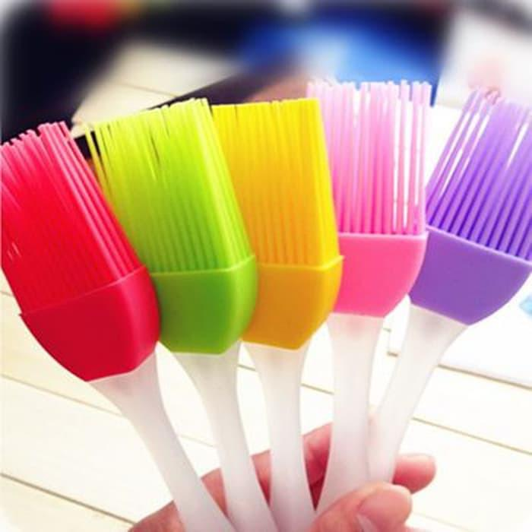
HDBscan + GridSearchCV
The score evaluation was implemented into a python Class in order to integrate it into GridSearchCV
As well, the NLP test treatment was integrated to generate a separate feature matrix. These two feature matrices were then normalized and concatenated in order to use in GridSearchCV.
For a 2,000 test image set of large groups, we get an f1 = 0.80
For a 4,600 test image set of purely random selection, we get an f1 = 0.661
There were issues implementing HDBscan on Kaggle but inferring the gridsearch results for Dbscan gives 0.717 (on my laptop)

Slide 17
Also tried:
Kaggle would not play nice with our final step of generating a 75,000 x 75,000 numpy array. We tried:
Batch processing, np.memmap, gc.enable(), gc.collect()
Reducing the floating precision
For the latter, I learned that if X1 & X1 are np.float16, then:
%timeit np.dot(X1,X2)
54.4 s ± 134 ms per loop (mean ± std. dev. of 7 runs, 1 loop each)
Whereas:
%timeit np.dot(X1.astype(np.float32),X2.astype(np.float32)).astype(np.float16)
161 ms ± 2.56 ms per loop (mean ± std. dev. of 7 runs, 10 loops each)

